Slide 1
Math. for CS
Ch 5- Induction
Prof. Shunxiang Zhang
Anhui University of Science & Technology
Computer Science and Engineering
Mobile Phone：189-6377-7827
Email：sxzh666@gmail.com;sxzhang@aust.edu.cn

Slide 2
Topics covered/Contents
5.1 Ordinary Induction
5.2 Strong Induction
5.3 Strong Induction vs. Induction vs. Well Ordering

Slide 3
5 Induction
Induction is a powerful method for showing a property is true for all nonnegative integers. Induction plays a central role in discrete mathematics and computer science. In fact, its use is a defining characteristic of discrete—as opposed to continuous—mathematics. This chapter introduces two versions of induction, Ordinary and Strong, and explains why they work and how to use them in proofs. It also introduces the Invariant Principle, which is a version of induction specially adapted for reasoning about step-by-step processes.

Slide 4
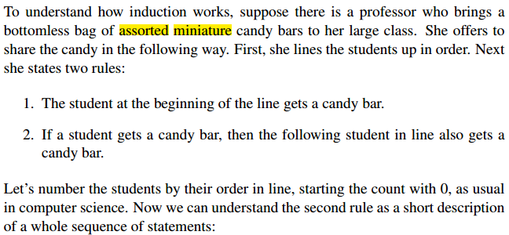
5.1 Ordinary Induction

Slide 5
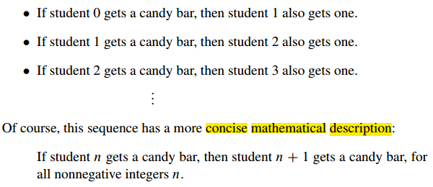
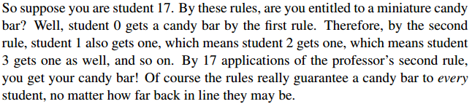
5.1 Ordinary Induction

Slide 6
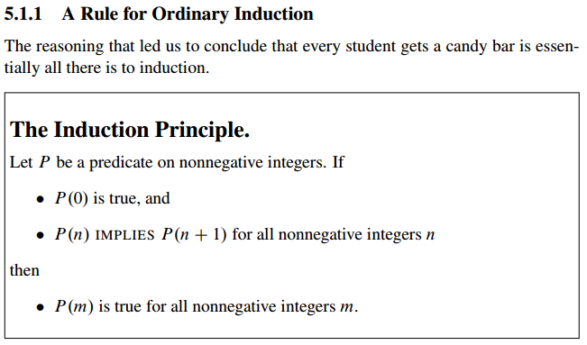
5.1 Ordinary Induction

Slide 7
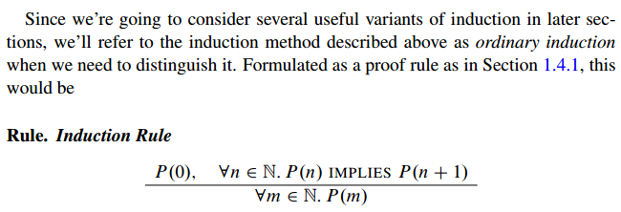
5.1 Ordinary Induction

Slide 8
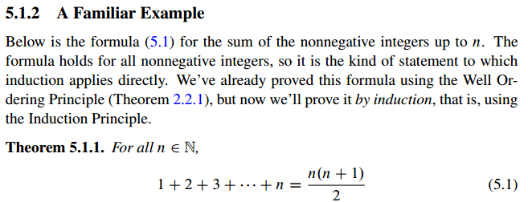
5.1 Ordinary Induction

Slide 9
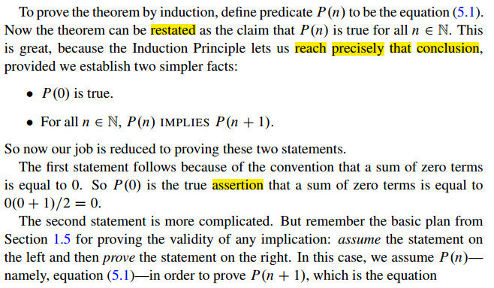
5.1 Ordinary Induction

Slide 10
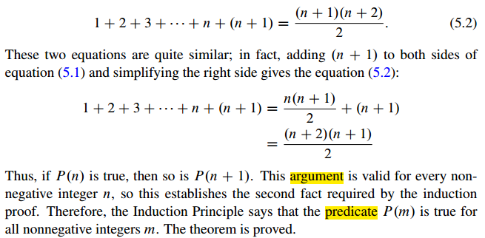
5.1 Ordinary Induction

Slide 11
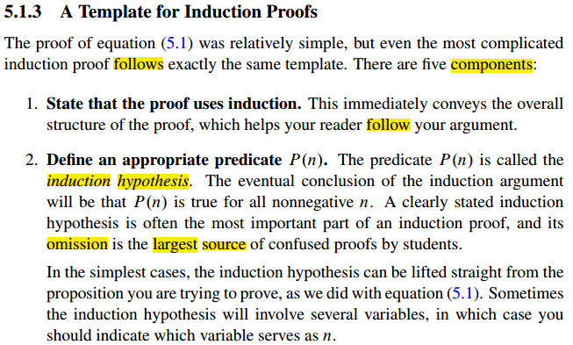
5.1 Ordinary Induction

Slide 12
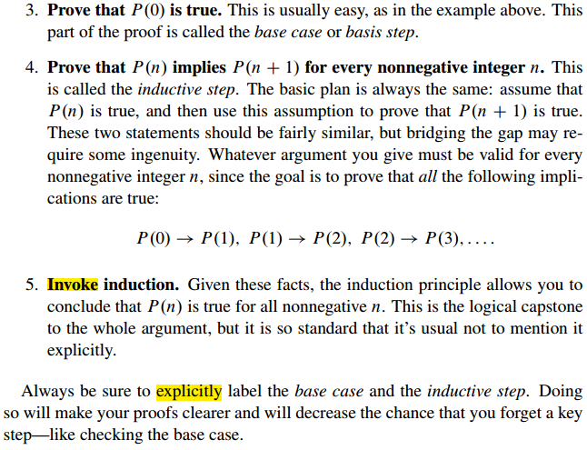
5.1 Ordinary Induction

Slide 13
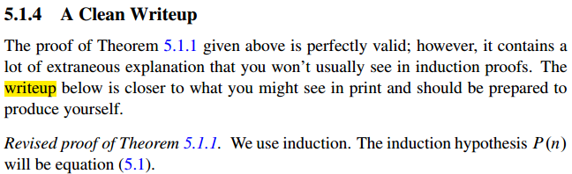
5.1 Ordinary Induction

Slide 14
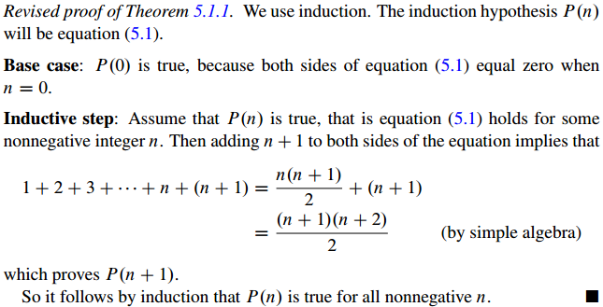
5.1 Ordinary Induction

Slide 15
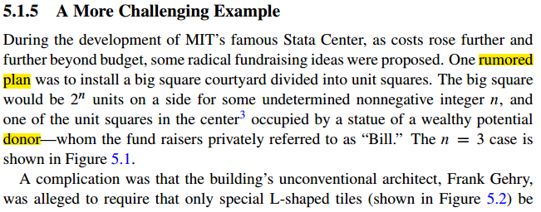
5.1 Ordinary Induction

Slide 16
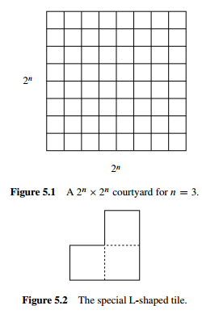
5.1 Ordinary Induction

Slide 17
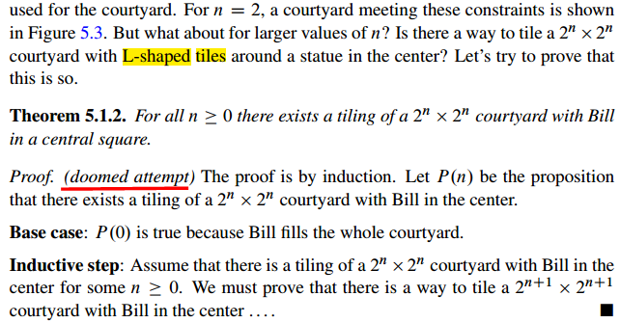
5.1 Ordinary Induction

Slide 18
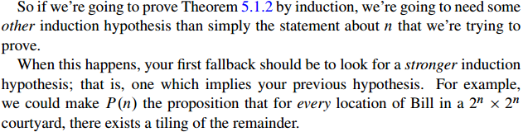
5.1 Ordinary Induction
Now we’re in trouble! The ability to tile a smaller courtyard with Bill in the center isn’t much help in tiling a larger courtyard with Bill in the center. We haven’t figured out how to bridge the gap between P(n) and P(n+1).

Slide 19
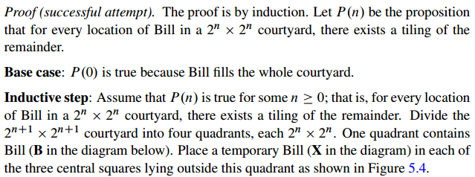
5.1 Ordinary Induction

Slide 20
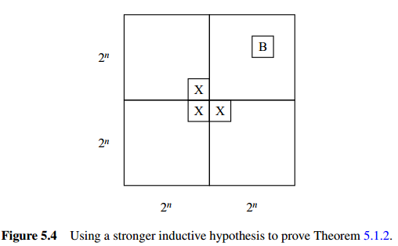
5.1 Ordinary Induction

Slide 21
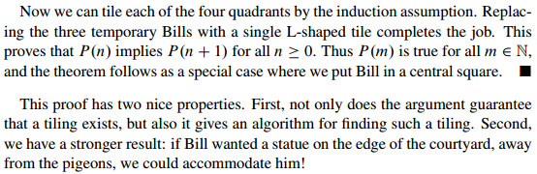
5.1 Ordinary Induction

Slide 22
5.2 Strong Induction

Slide 23
5.2 Strong Induction

Slide 24
5.3 Strong Induction vs. Induction vs. Well Ordering

Slide 25

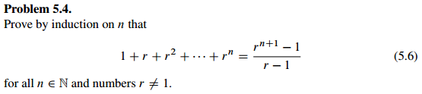
5.3 Group/Panel discussion
Group 1

Slide 26
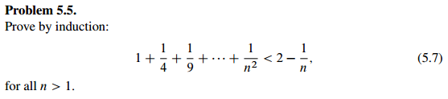
5.3 Group/Panel discussion
Group 1

